Slide 1
GPIO
HCM - 2021

Slide 2
Agenda
Memory Mapping
Registers
Block Diagram
Example

Slide 3
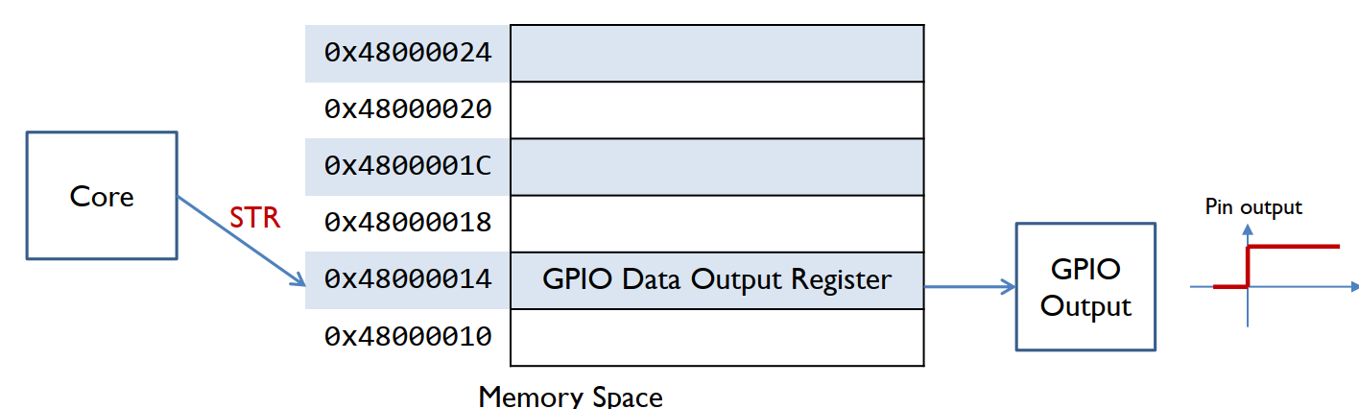
Interfacing Peripherals
Port-mapped I/O
Use special CPU instructions: Special_instruction Reg, Port
Memory-mapped I/O
A simpler and more convenient way to interface I/O devices
Each device registers is assigned to a memory address in the address space of the microprocessor
Use native CPU load/store instructions: LDR/STR Reg, [Reg, #imm]

Slide 4
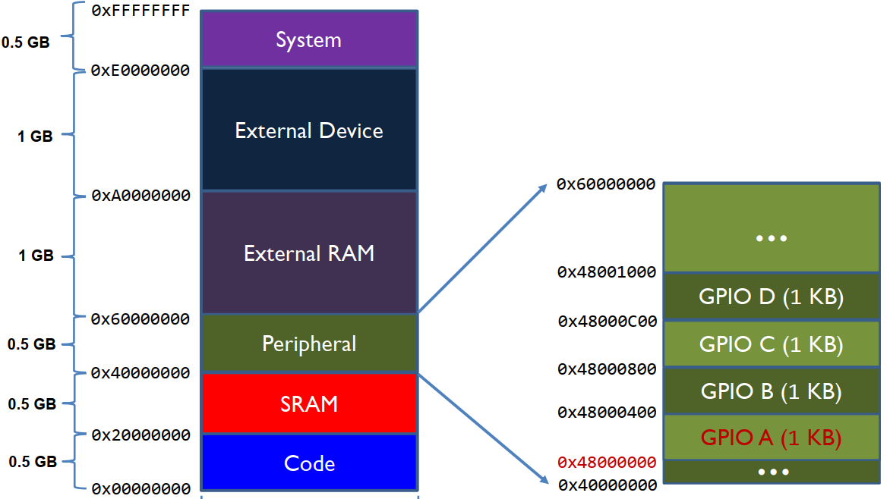
Memory Map of Cortex-M4

Slide 5
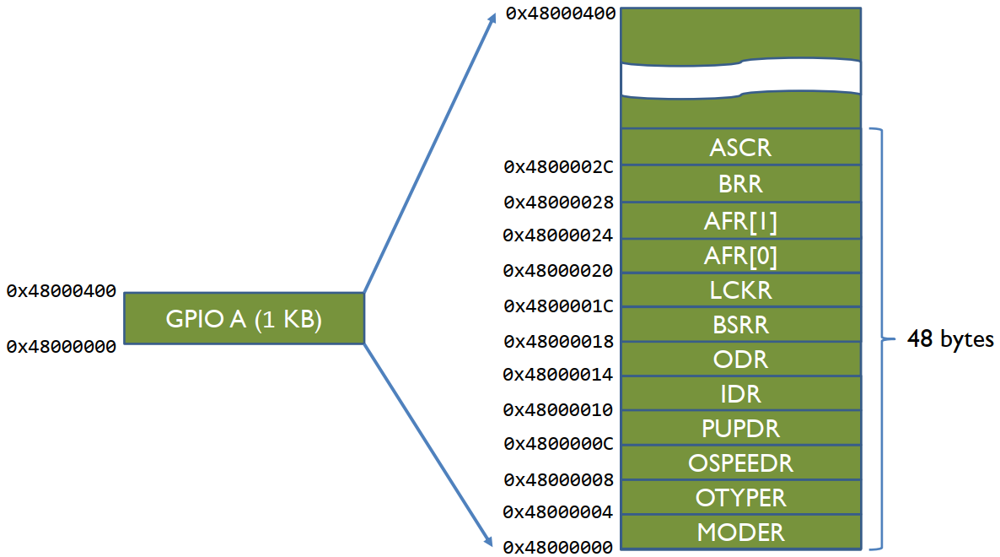
GPIO Memory Map

Slide 6
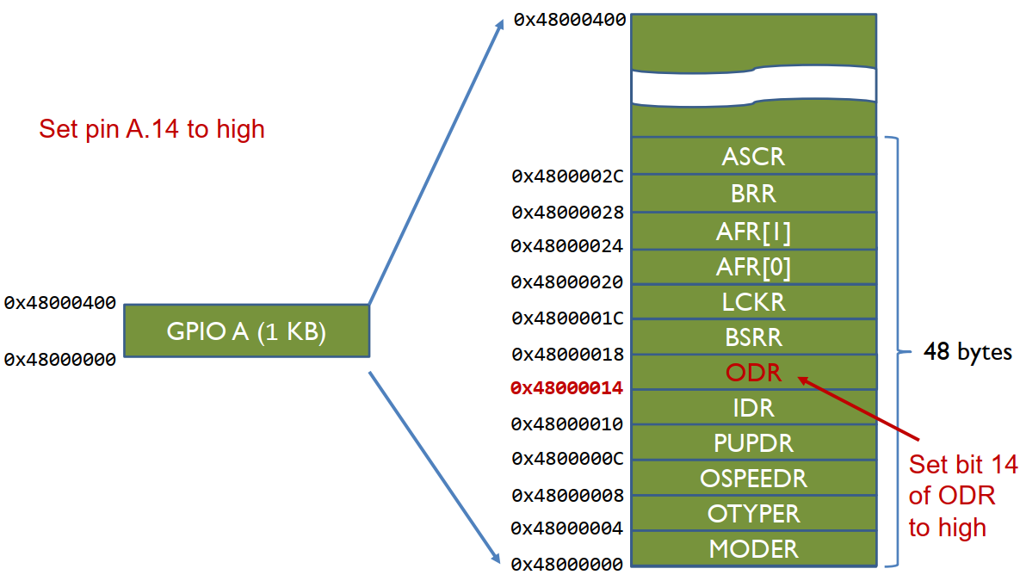
GPIO Memory Map

Slide 7
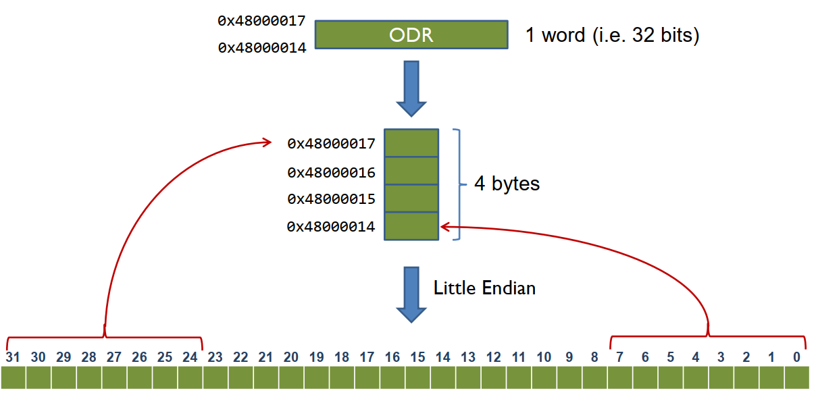
Output Data Register (ODR)

Slide 8
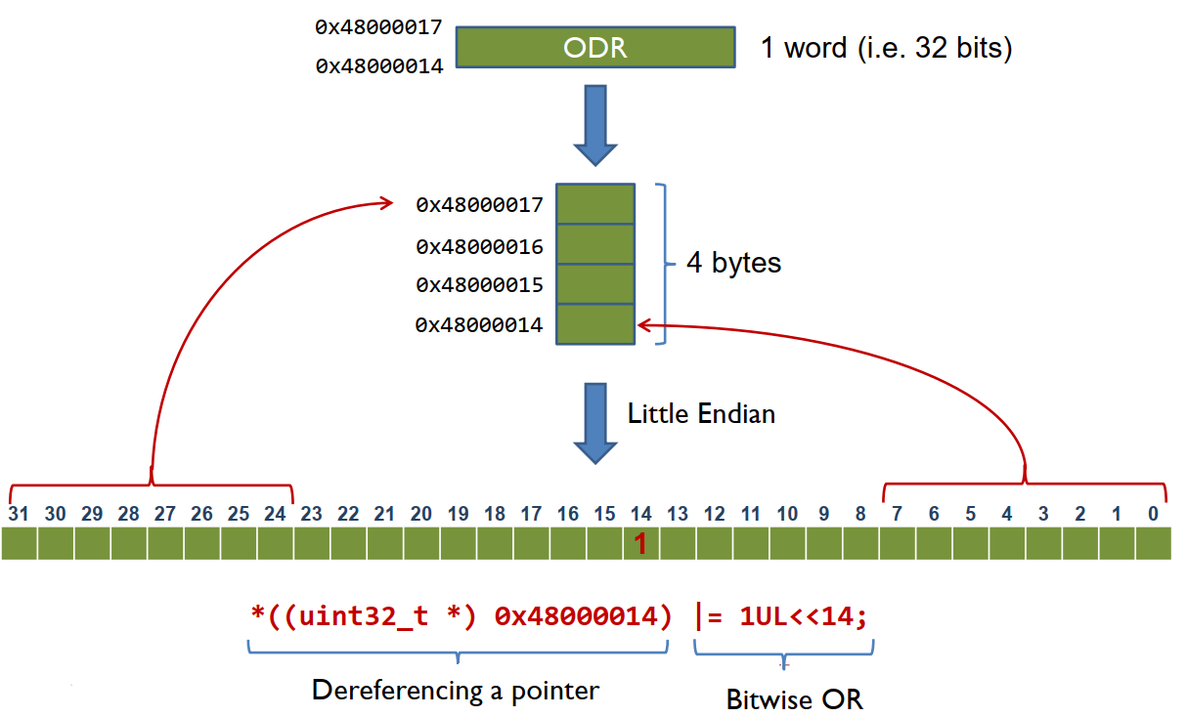
Output Data Register (ODR)

Slide 9
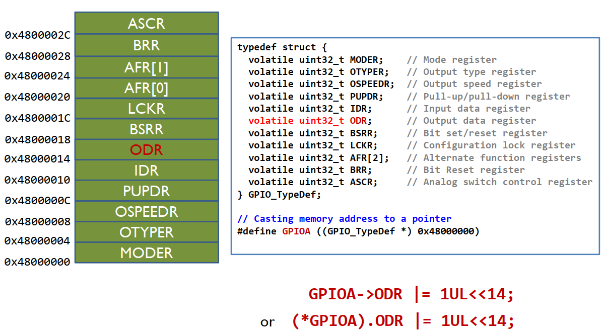
Dereferencing a Memory Address

Slide 10
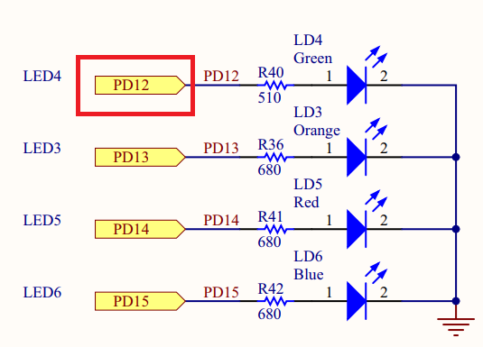
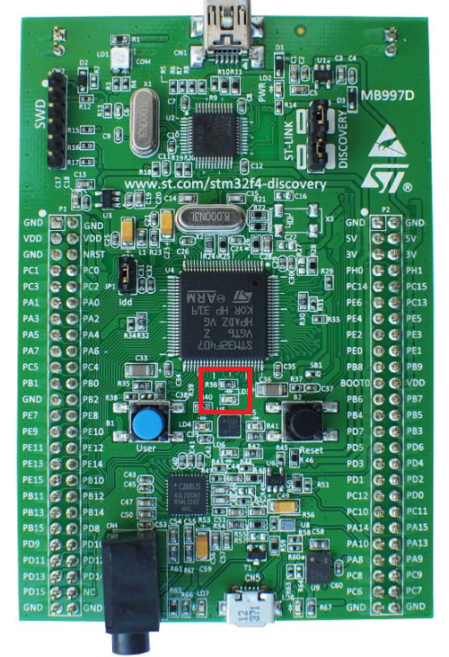
LED (PD.12)
PD.12 | Green LED
High | On
Low | Off

Slide 11
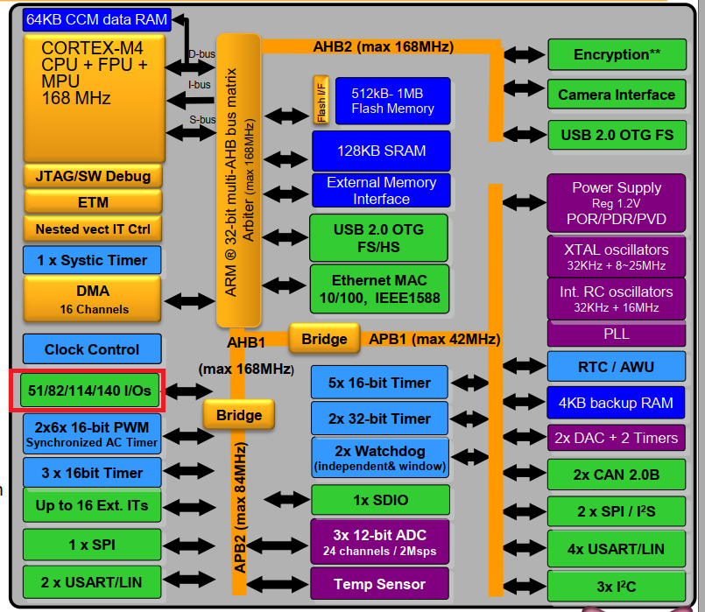
General Purpose Input/Output (GPIO)
8 GPIO Ports:
A, B, C, D, E, F, G, H
Up to 16 pins in each port

Slide 12
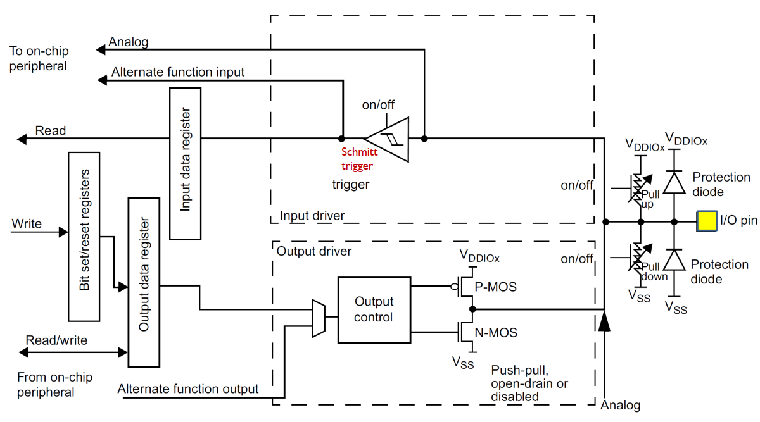
GPIO Configuration Modes

Slide 13
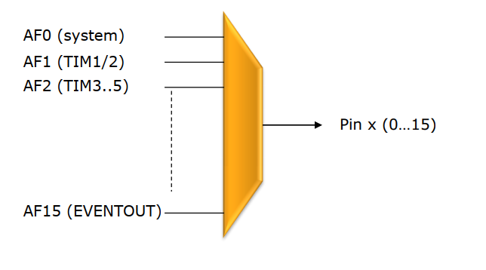
Alternate Functions features
Most of the peripherals shares the same pin (like USARTx_Tx, TIMx_CH2,
I2Cx_SCL, SPIx_MISO, EVENTOUT…)
Alternate functions multiplexers prevent to have several peripheral’s function
pin to be connected to a specific I/O at a time.
Some Alternate function pins are remapped to give the possibility to optimize
the number of peripherals used in parallel.
Demux

Slide 14
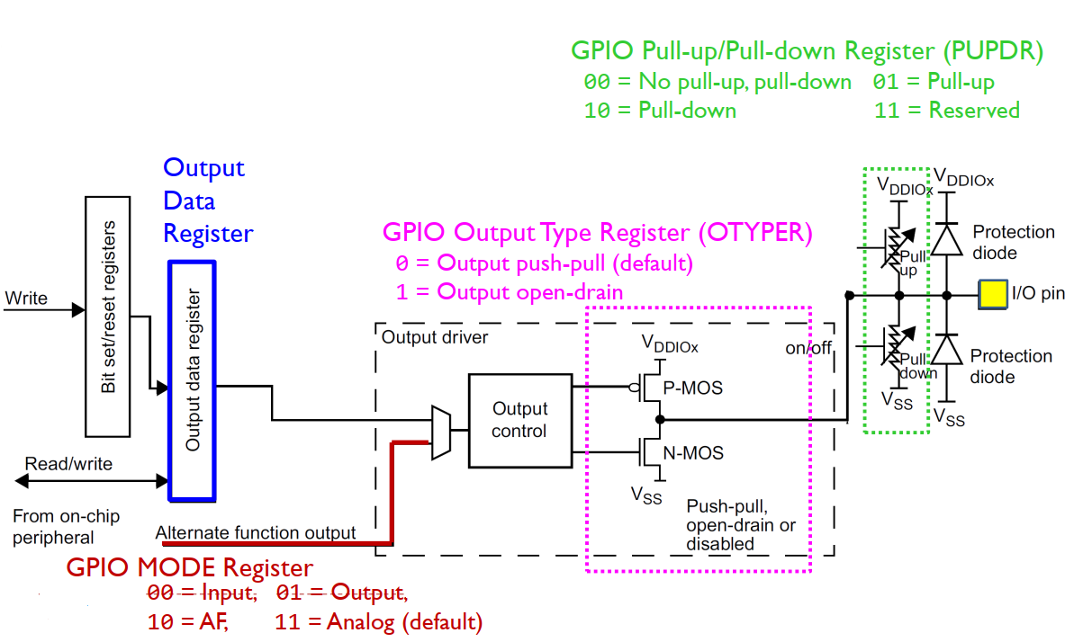
Basic Structure of an I/O Port Bit: Output

Slide 15
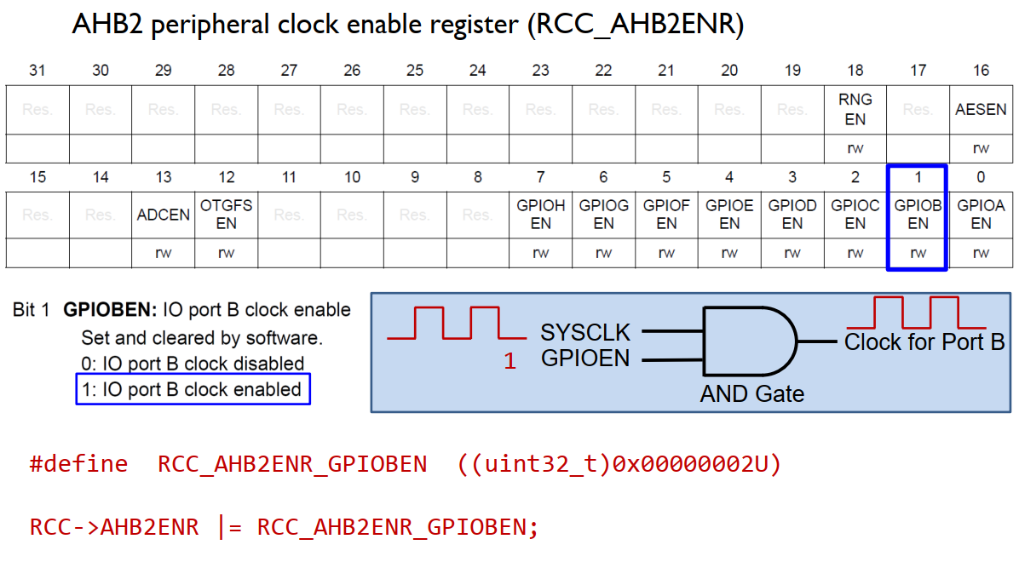
Enable Clock

Slide 16
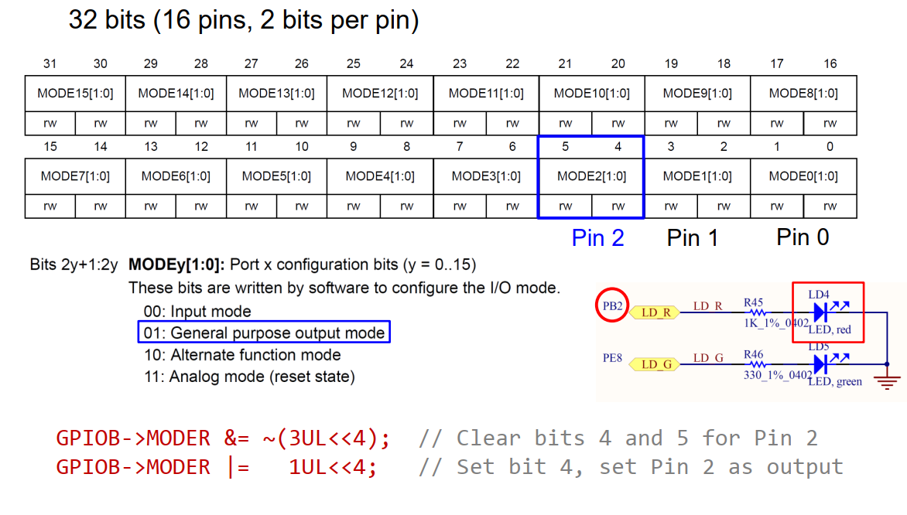
GPIO Mode Register (MODER)

Slide 17
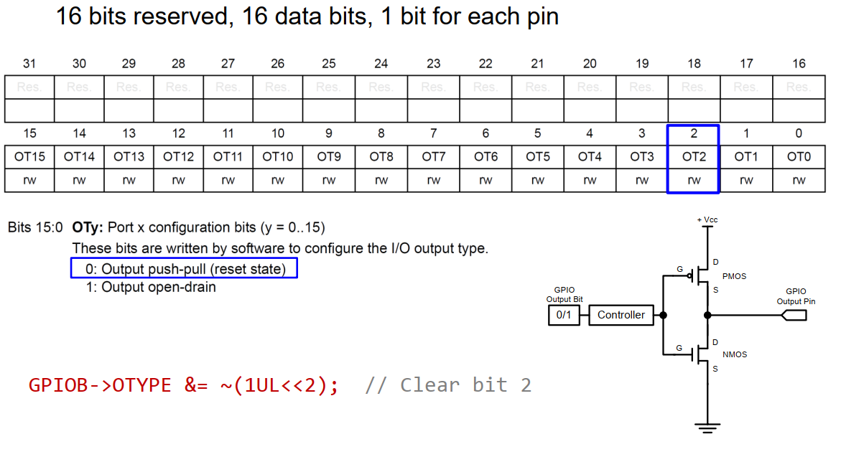
GPIO Output Type Register (OTYPE)

Slide 18
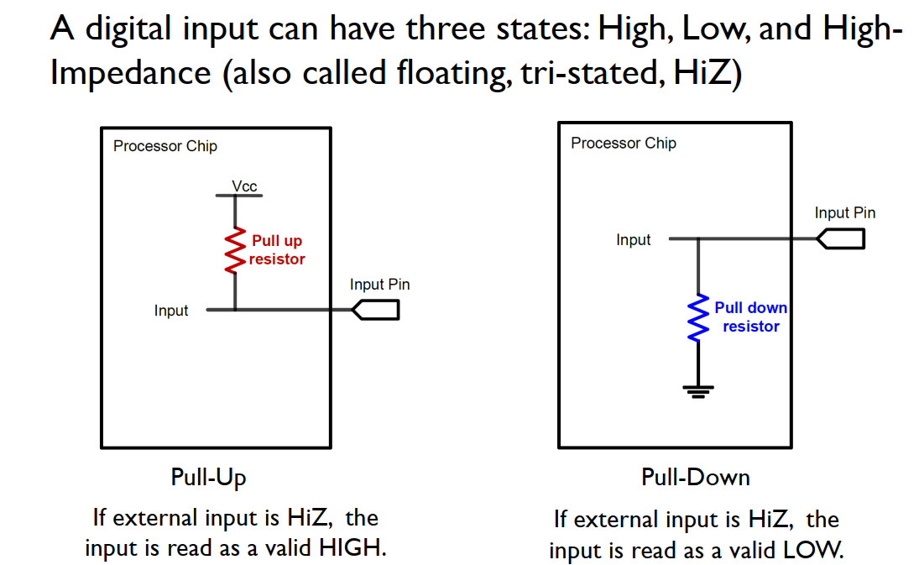
GPIO Input: Pull Up

Slide 19
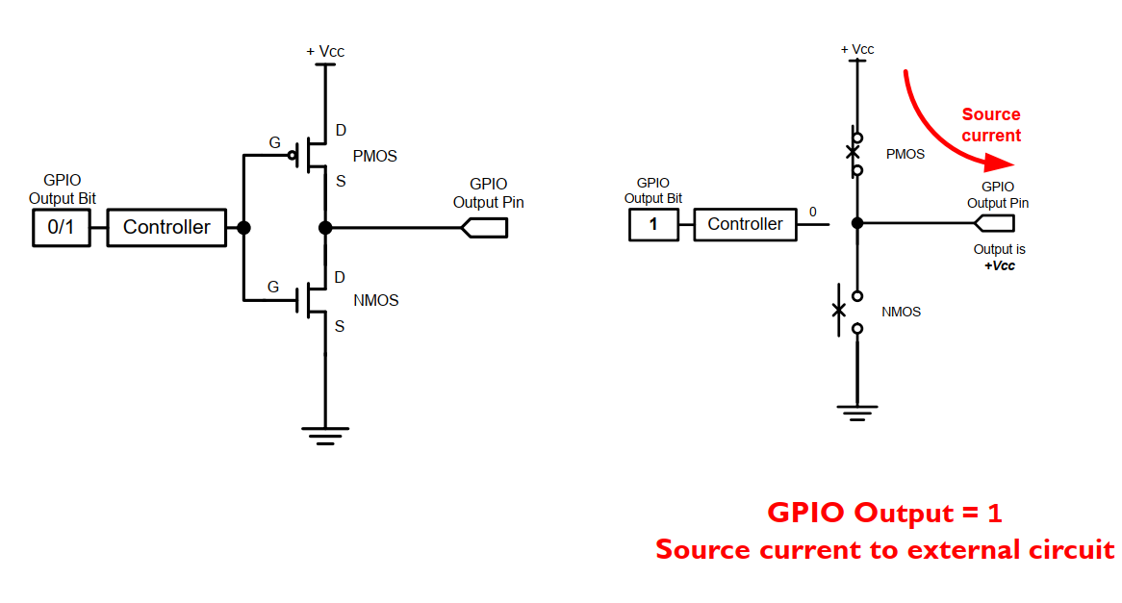
GPIO Output: Push-Pull

Slide 20
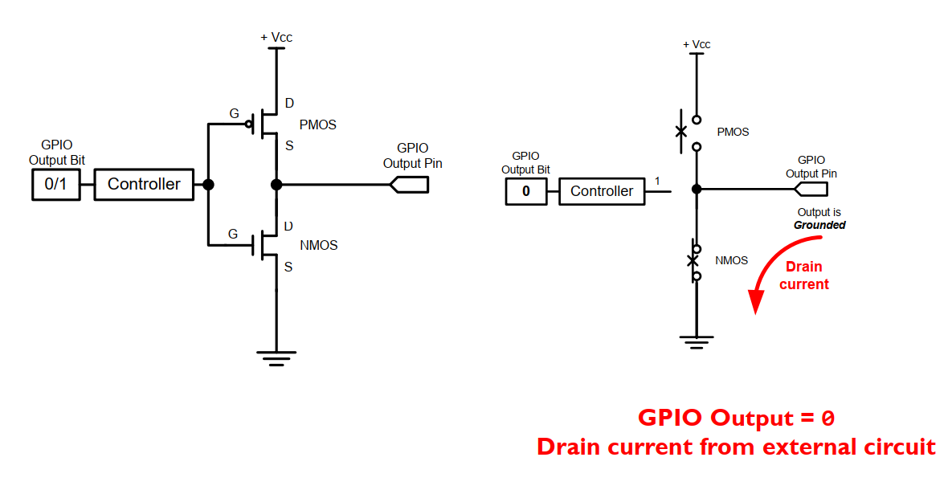
GPIO Output: Push-Pull

Slide 21
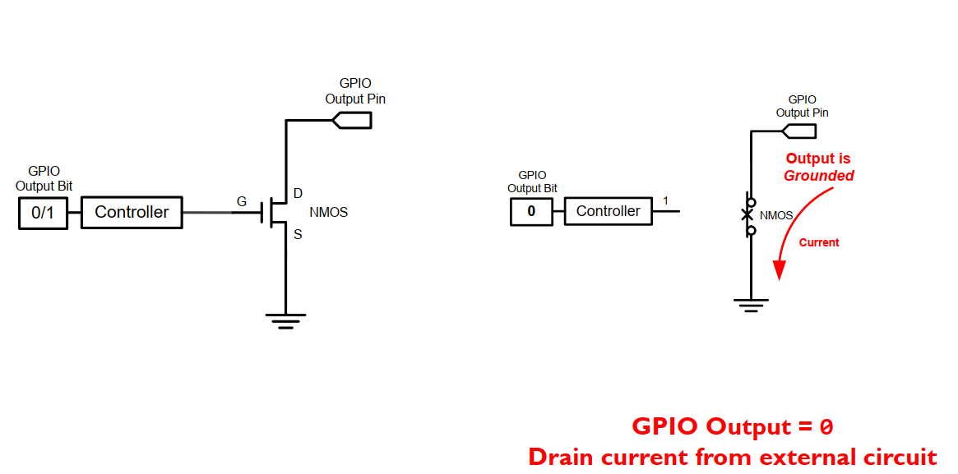
GPIO Output: Open-Drain

Slide 22
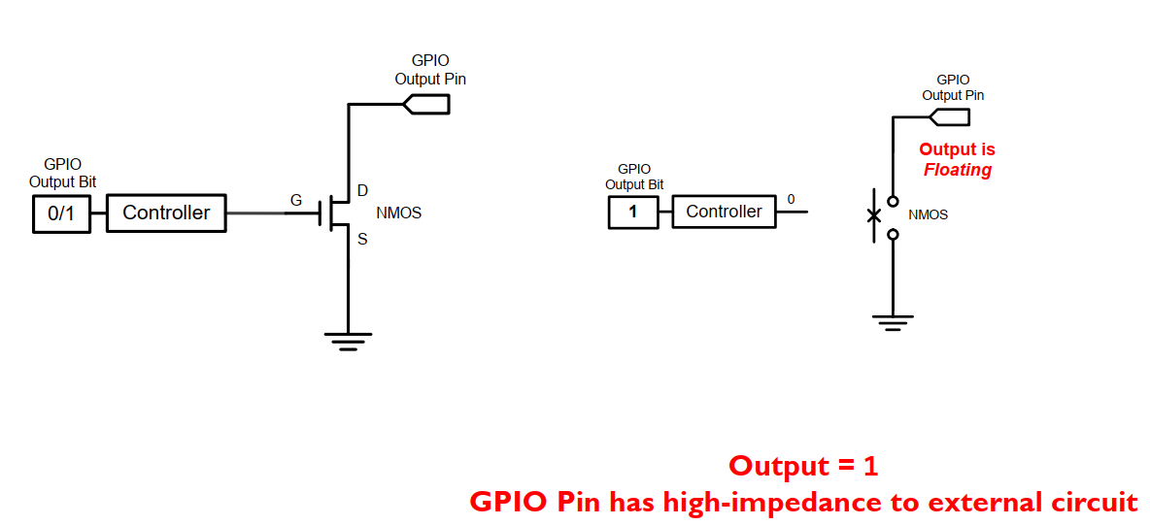
GPIO Output: Open-Drain

Slide 23
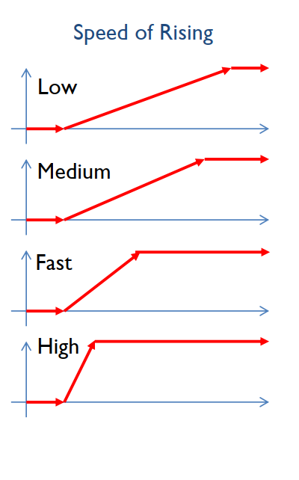
GPIO Output Speed
Output Speed:
Speed of rising and falling
Four speeds: Low, Medium, Fast, High
Tradeoff
Higher GPIO speed increases EMI noise and power consumption
Configure based on peripheral speed
Low speed for toggling LEDs
High speed for SPI

Slide 24
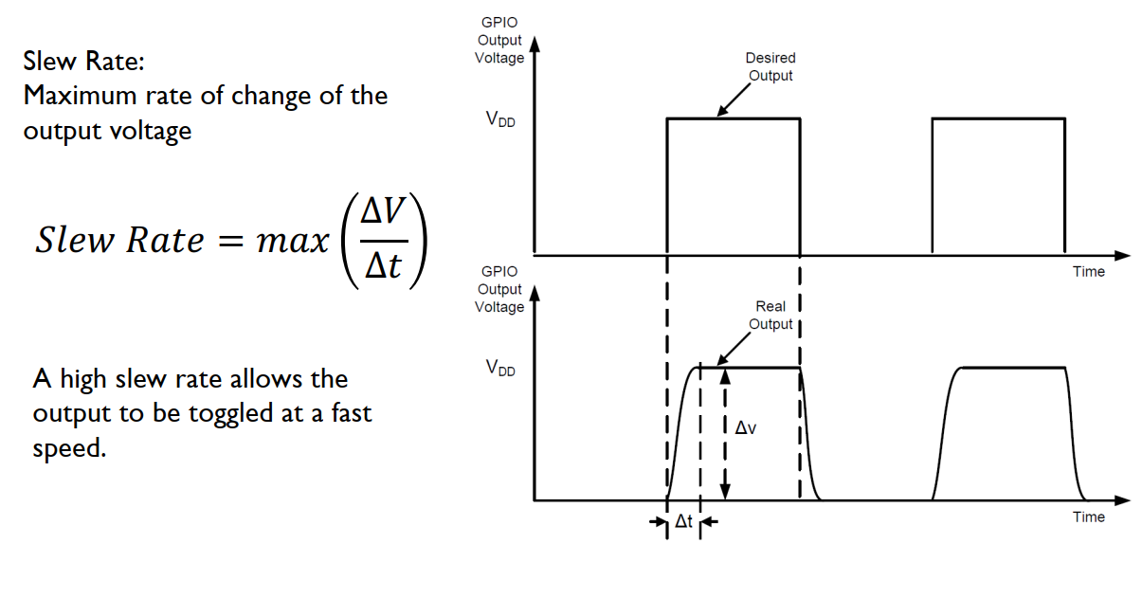
Slew Rate

Slide 25
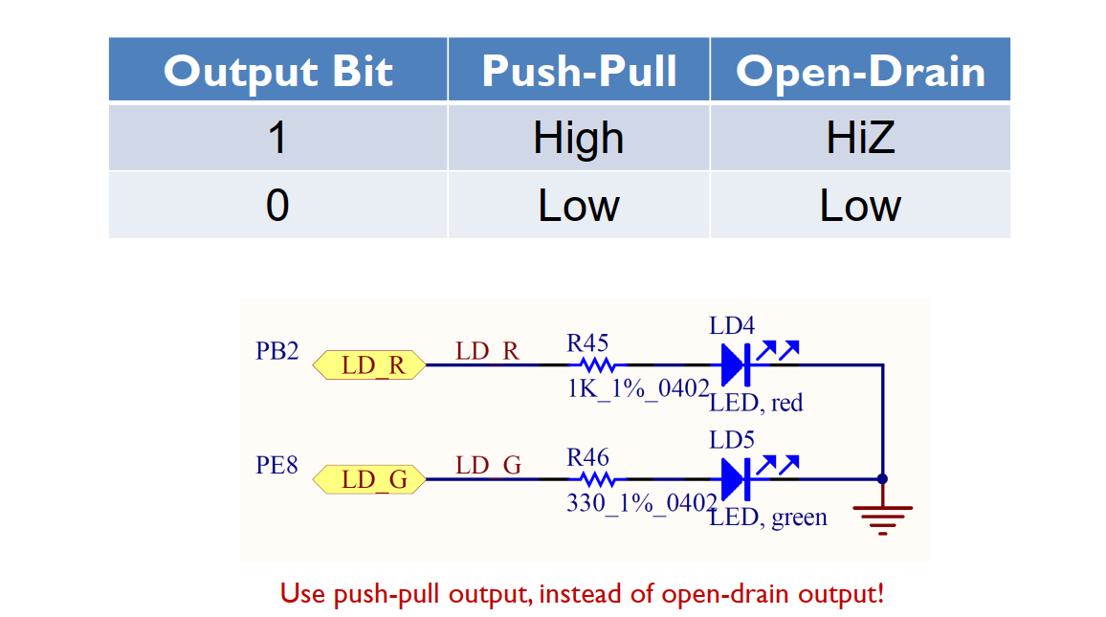
GPIO Output: Push-Pull vs Open-Drain

Slide 26
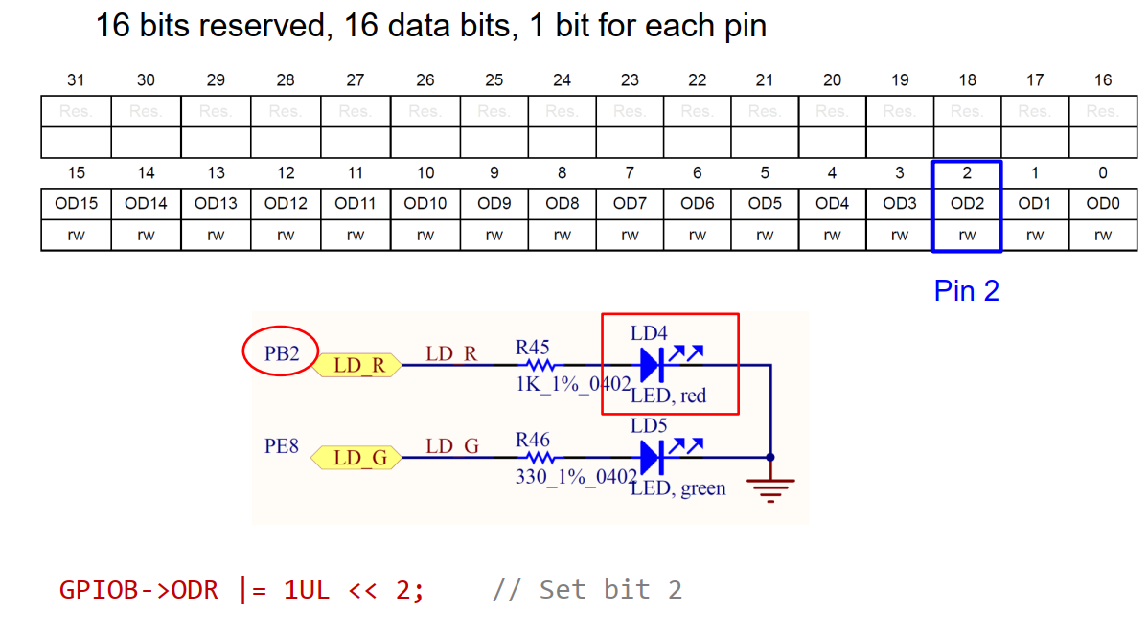
GPIO Output Data Register (ODR)

Slide 27
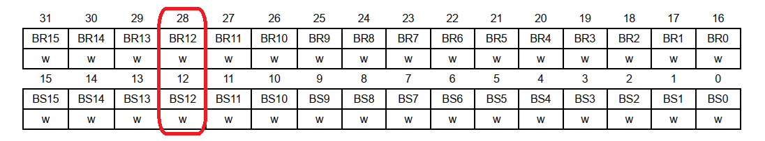
Bit set / reset register
BR12 = Bit Reset 12
BS12 = Bit Set 12
Offet: 28 - 12 = 16

Slide 28
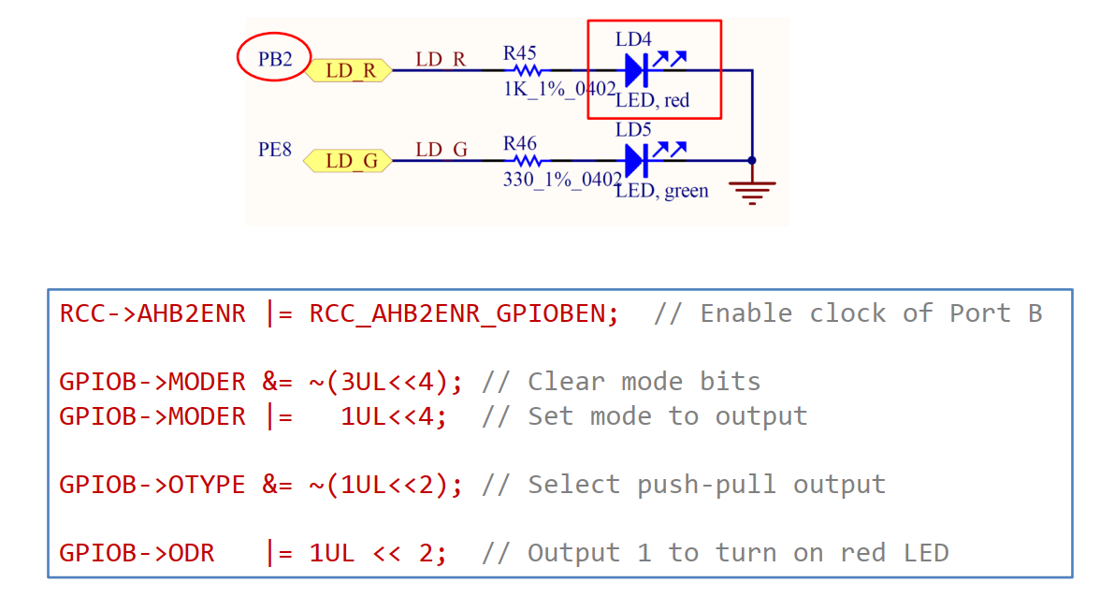
Light up the Red LED (PB.2)

Slide 29
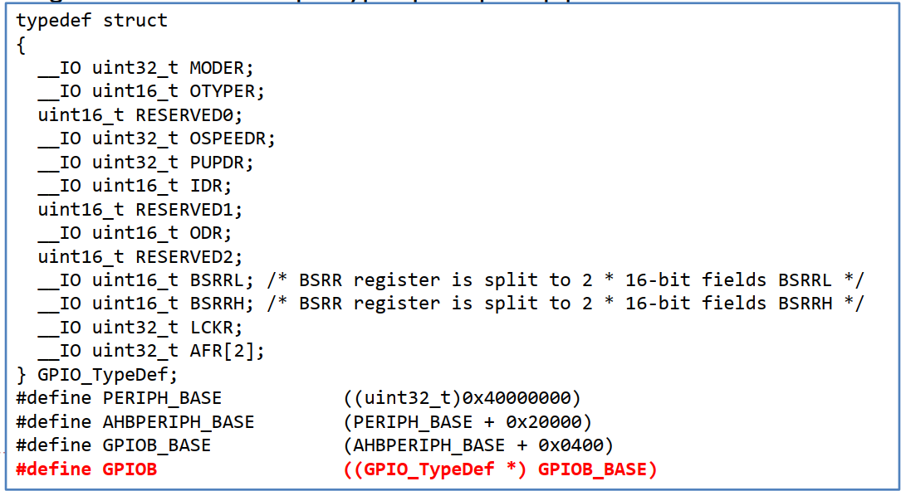
GPIO Initialization
Turn on the clock to the GPIO Port (e.g. Port B)
Configure GPIO mode, output type, speed, pull-up/pull-down

Slide 30
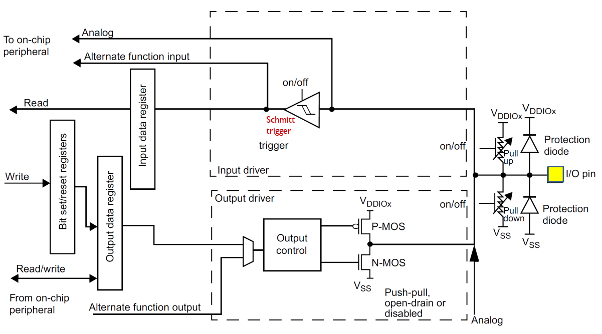
Basic Structure of an I/O Port Bit Input and Output

Slide 31
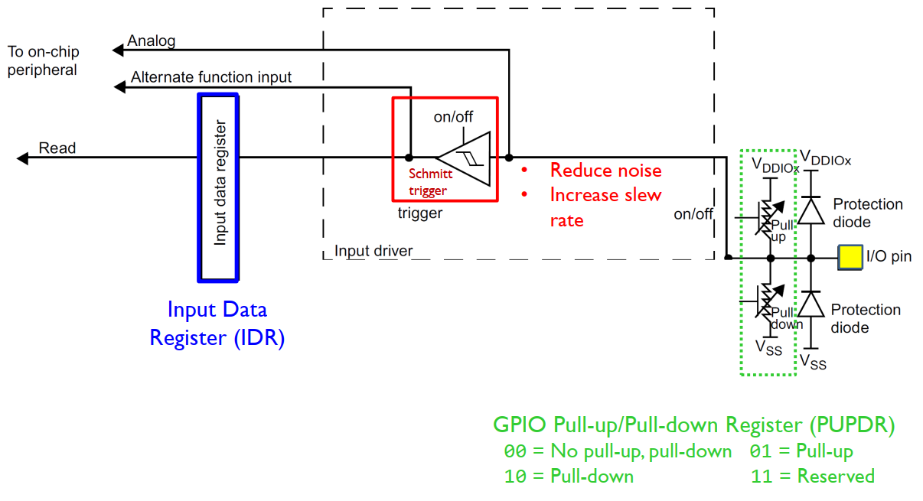
Basic Structure of an I/O Port Bit: Input

Slide 32
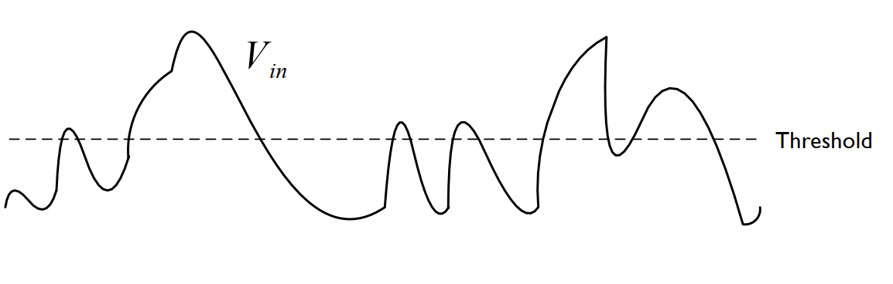
Schmitt Trigger
Analog signals
Noisy
Rise and fall slowly (small slew rate)

Slide 33
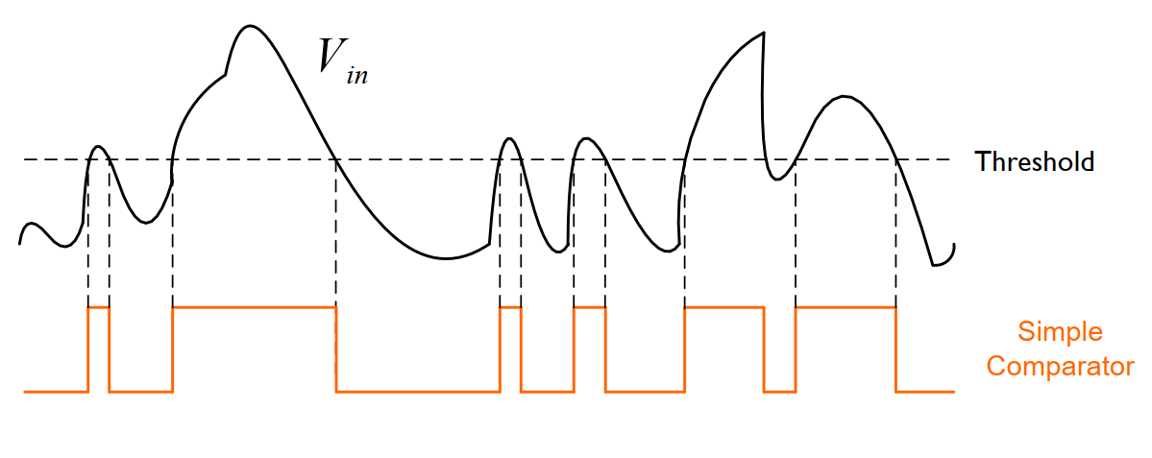
Schmitt Trigger

Slide 34
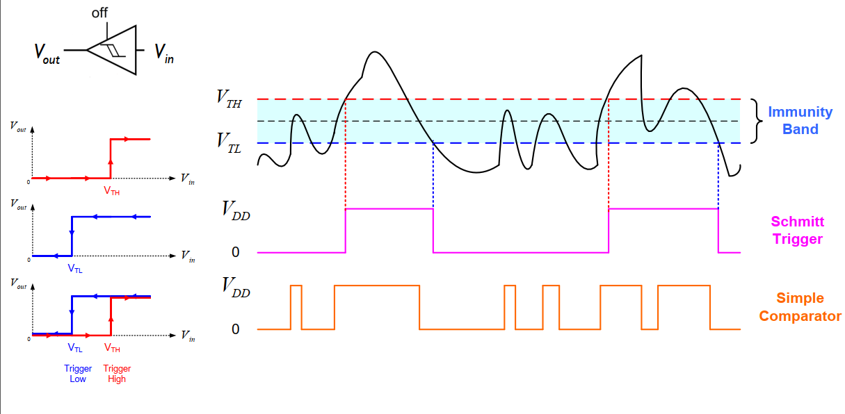
Schmitt Trigger

Slide 35
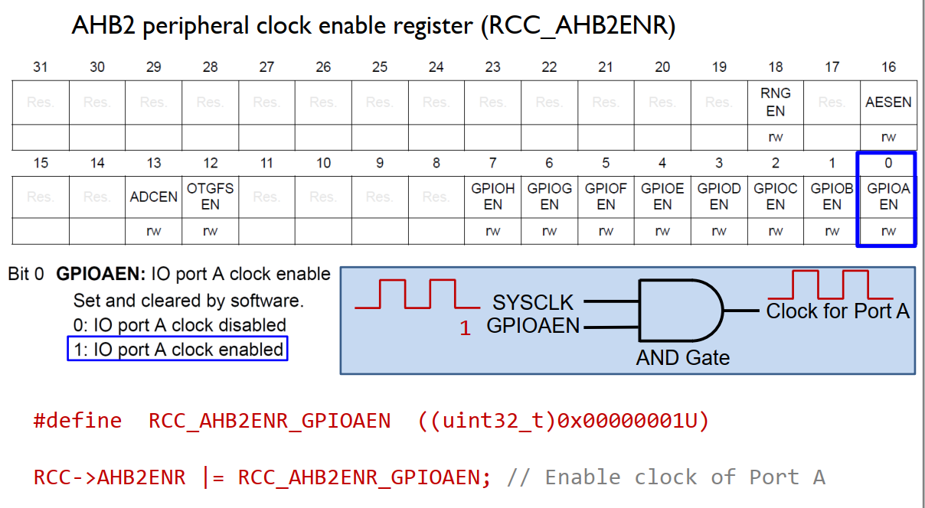
Enable Clock

Slide 36
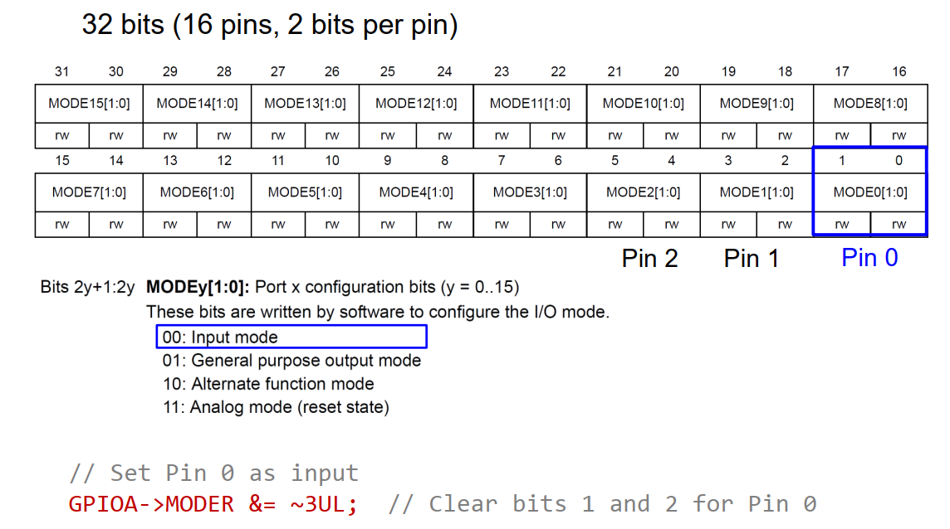
GPIO Mode Register (MODER)

Slide 37
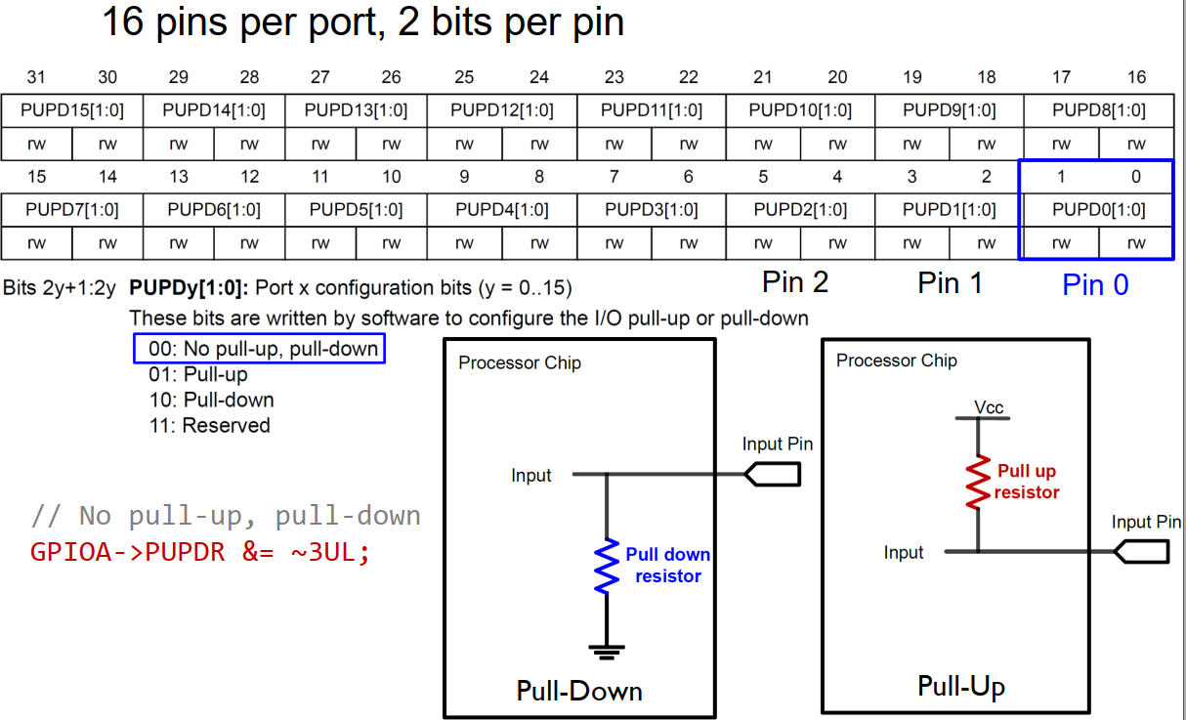
GPIO Pull-up/Pull-down Register PUPDR

Slide 38
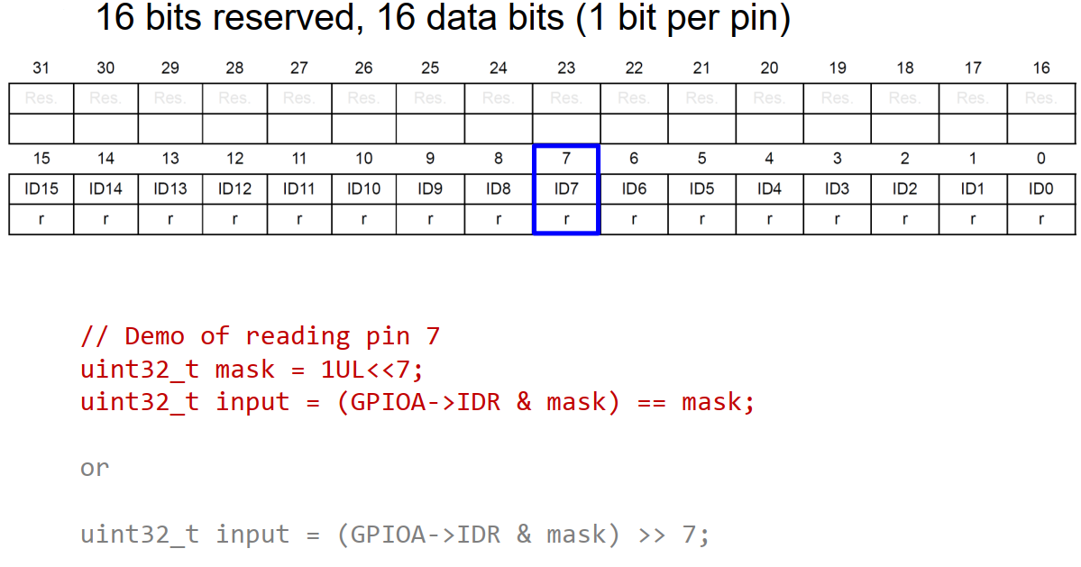
GPIO Input Data Register (IDR)

Slide 39
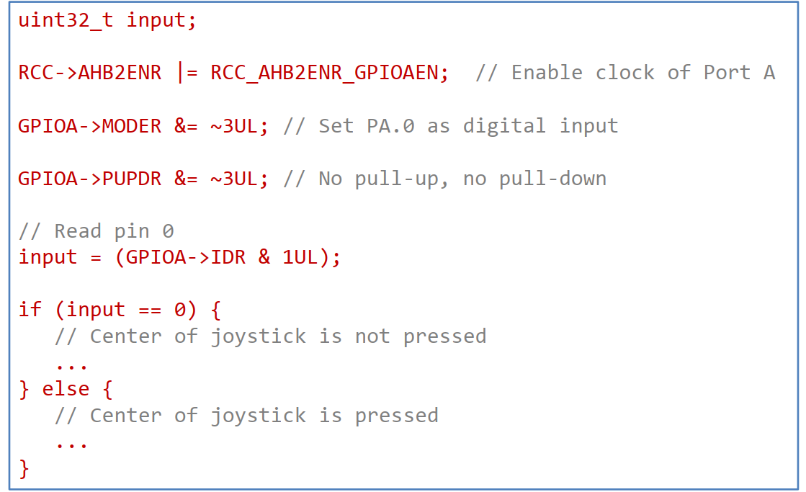
Read Input of Pin PA.0

Slide 40
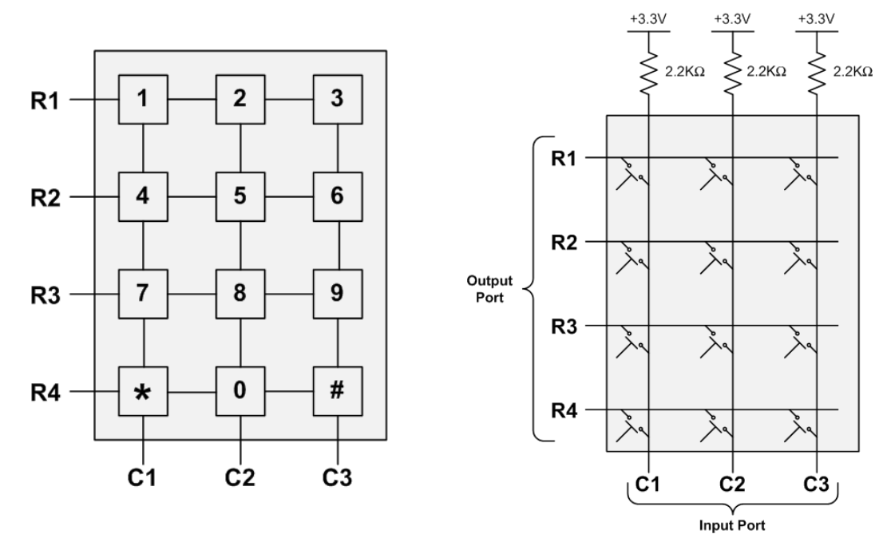
Keypad Scan

Slide 41
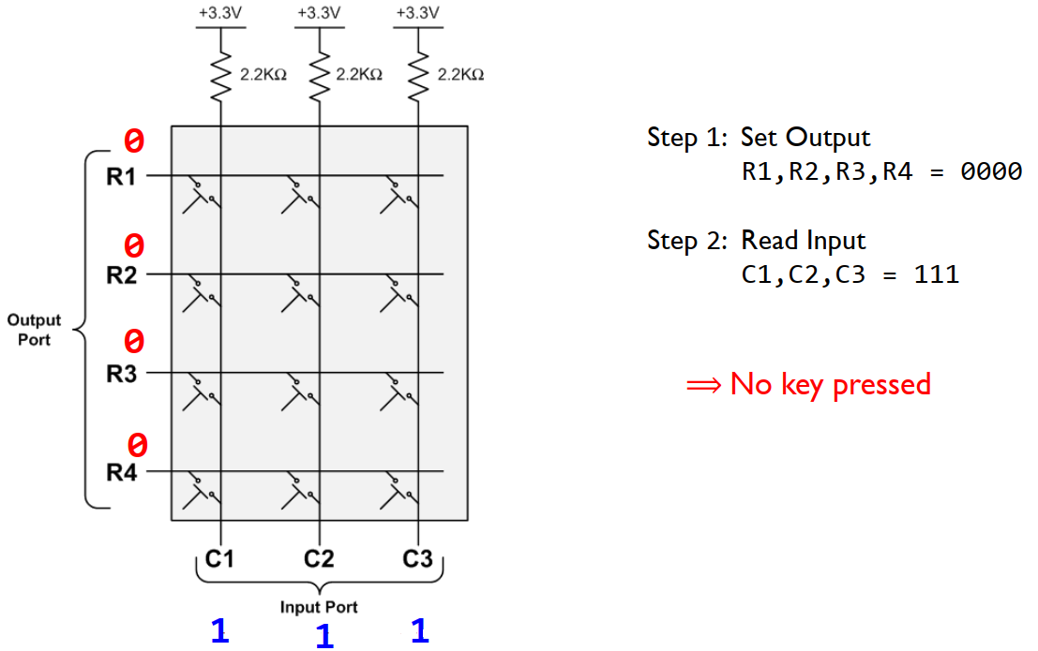
Keypad Scan

Slide 42
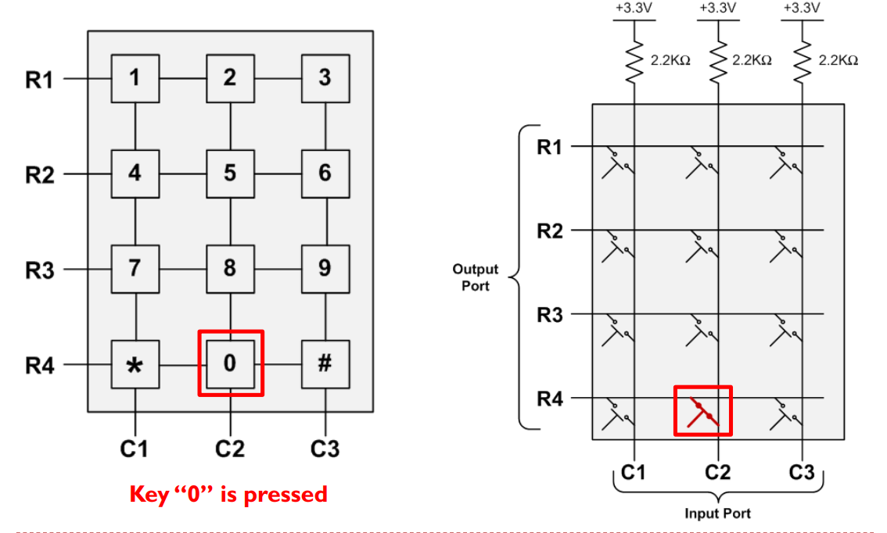
Keypad Scan

Slide 43
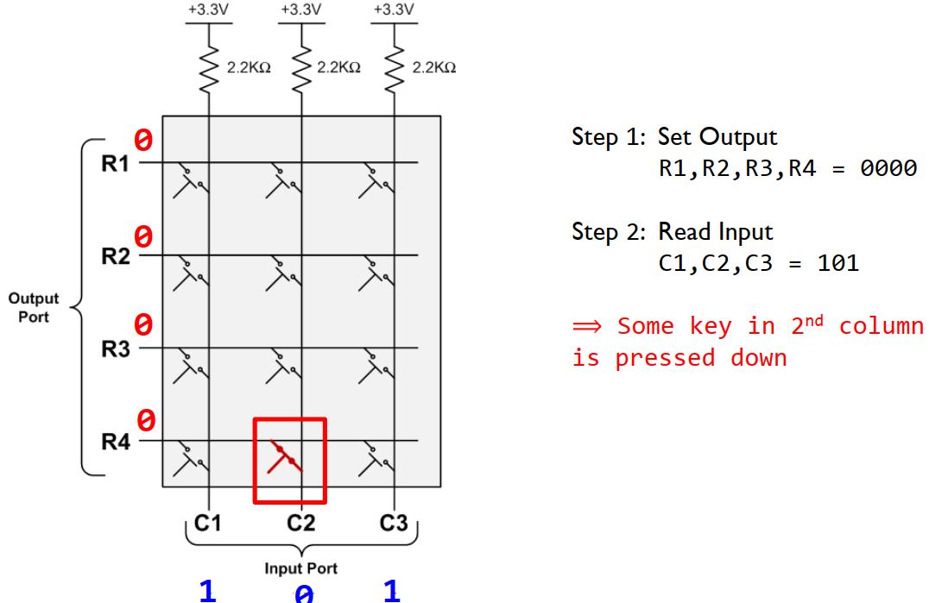
Keypad Scan

Slide 44
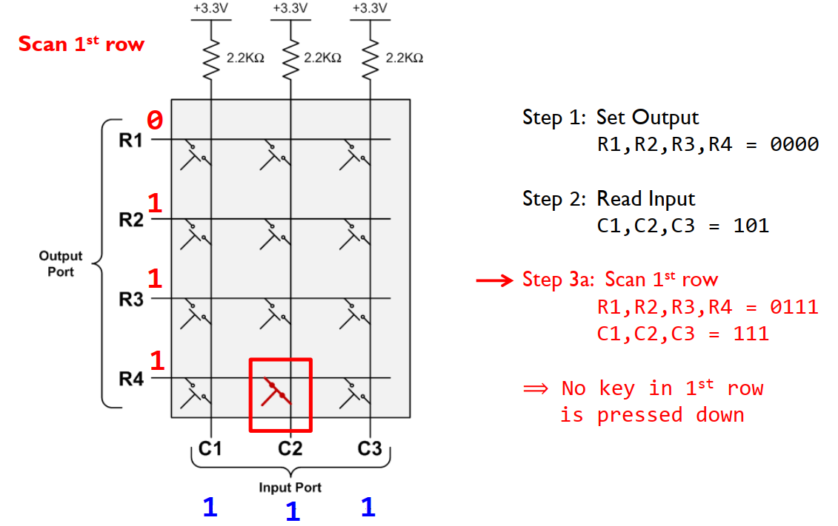
Keypad Scan

Slide 45
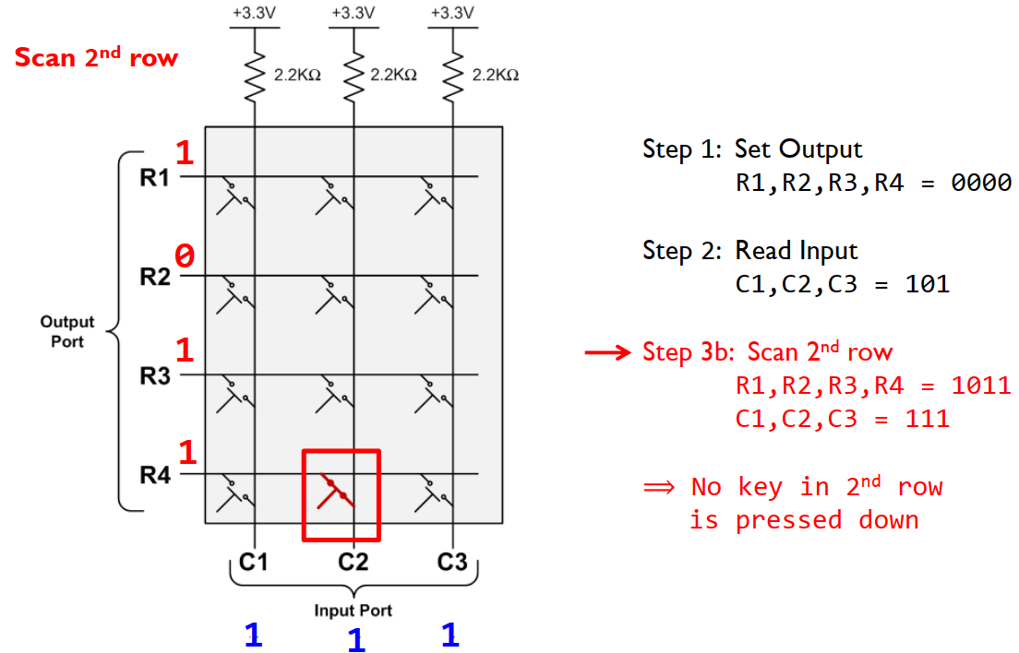
Keypad Scan

Slide 46
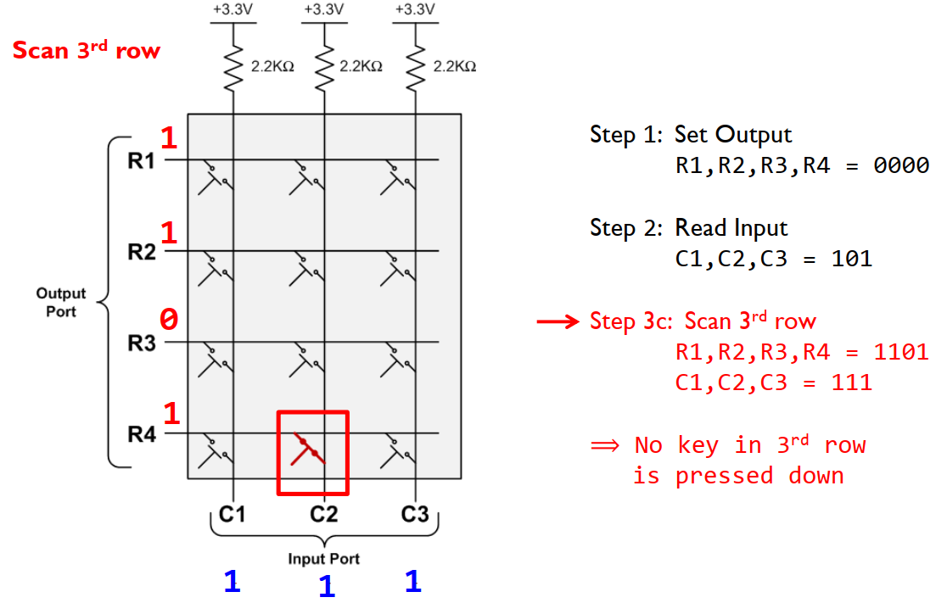
Keypad Scan

Slide 47
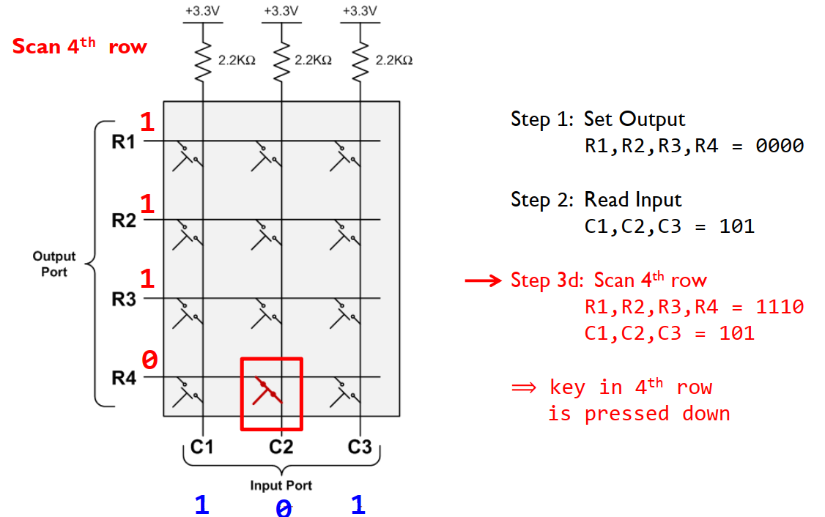
Keypad Scan

Slide 48
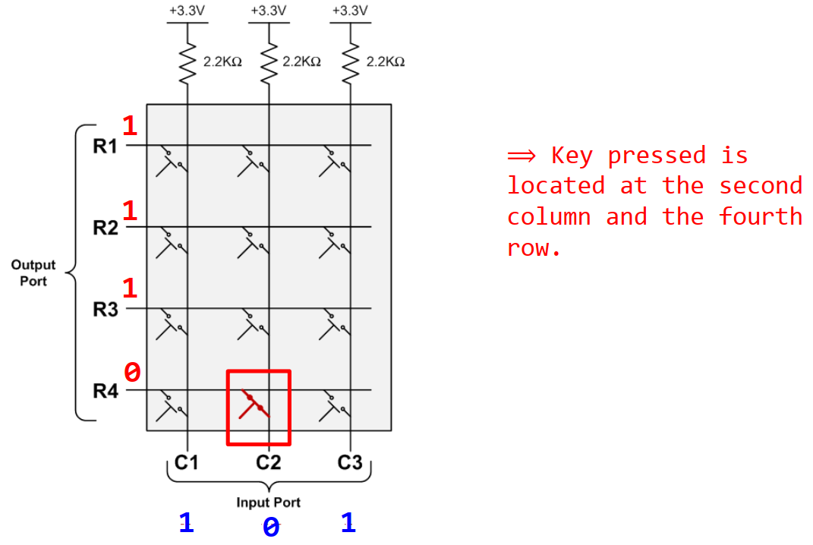
Keypad Scan

Slide 49
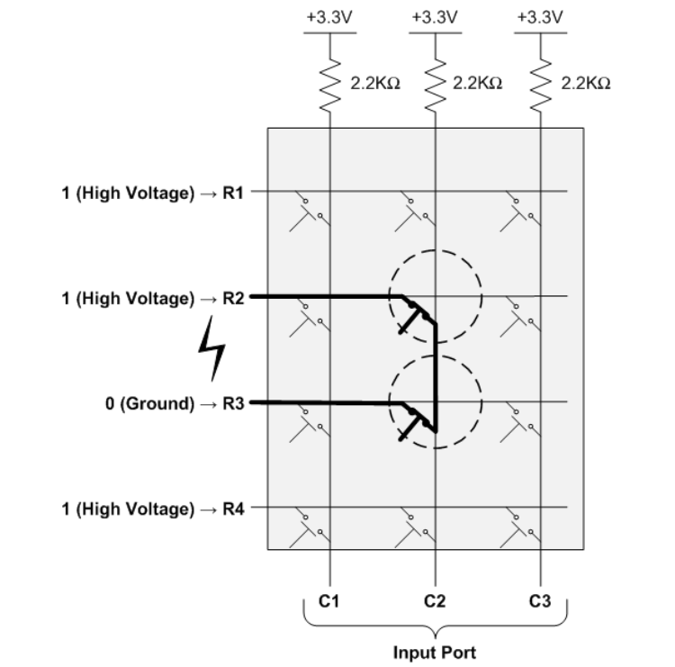
Keypad Scan

Slide 50
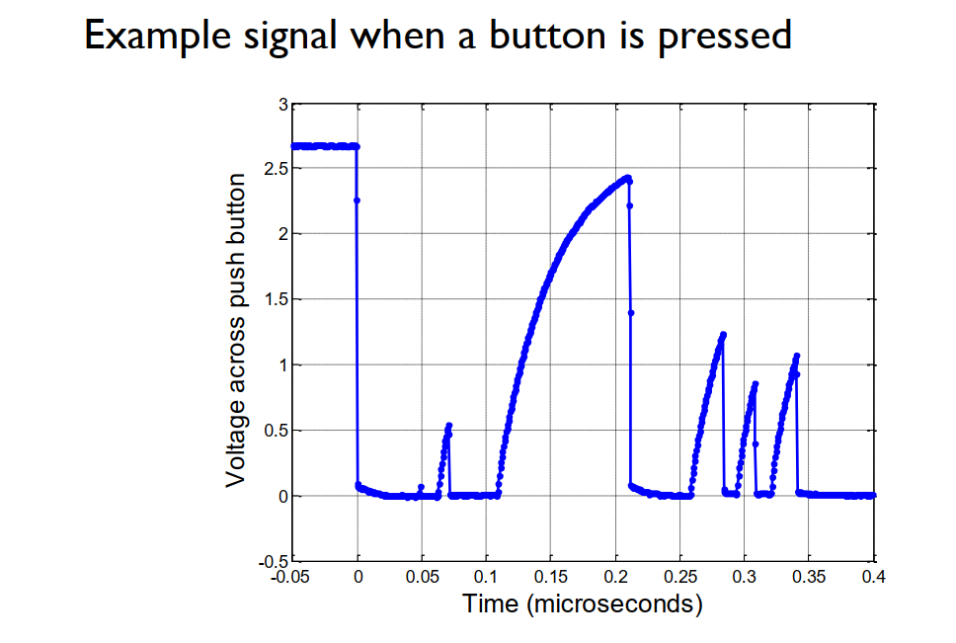
I/O Debouncing

Slide 51
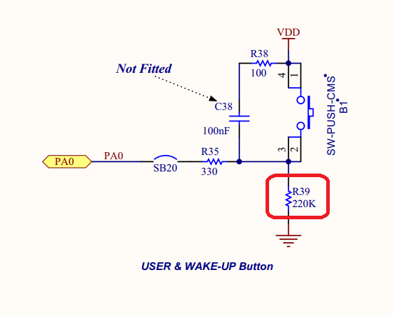
Button circuit
Pull-Down Resistor – default logic LOW

Slide 52
Debounce method
Use Timer and Interrupt to test the state of the switch (recommend)
Use polling method to test the state of the switch

Slide 53
Douce with Interrupt
Use the systick to generate 1mS interrupt to implementing the Input debounce.
The Input is recognize at 1 or 0 if it stay at 1 or 0 for a time > of REFdebounce.
If during the samples the input change from 0 to 1 to 0, every change reset the In1_0 and In1_1.
In this way when In1_0 or In1_1 exceeds or is equal to REFdebounce means that it were at 1 or 0 for at least of the REFdebounce Time.

Slide 54


Debounce Flow chart

Slide 55


Debouncing
Code cho flow xử lý chống nhiễu
Phát hiện timeout và restart

Slide 56

Debouncing
- Disable interrupt để không bị lặp lại
- Bật flag để systick check và gọi hàm xử lý debounce

Slide 57

Debouncing
Gọi hàm xử lý chống nhiễu khi phát hiện nhấn nút (interrupt)

Slide 58

Tạo hiệu ứng LED
Tạo hiệu ứng LED chạy nối tiếp với chu kỳ 1s

Slide 59

Tạo hiệu ứng LED
Xóa 3 bit tương ứng LED12 -> LED14
Tạo mặt nạ để bật từng bit
Eg. 0x01 << 12

Slide 60

Khai báo macro GPIO
GPIO config trong CubeMX sẽ được khai báo dạng macro trong file main.h

Slide 61
Question ?

